Slide 1
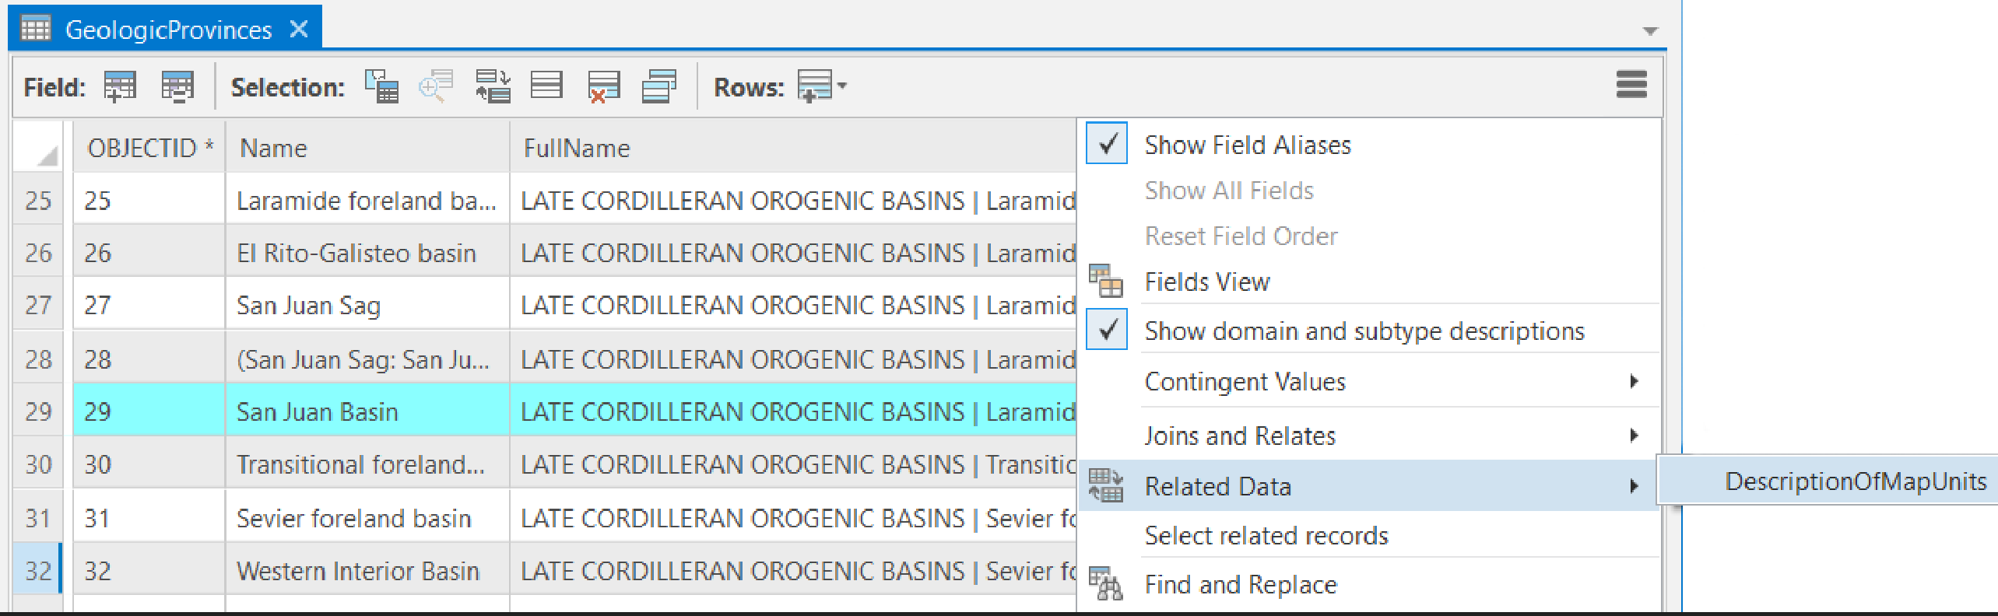
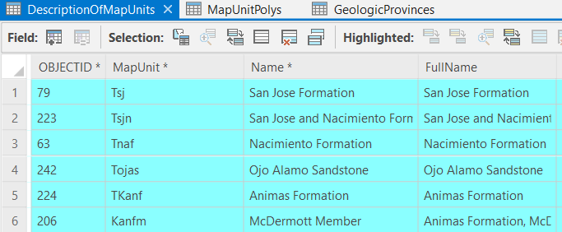
Map Unit Information—Using table to table
GeologicProvinces
DescriptionOfMapUnits

Slide 2
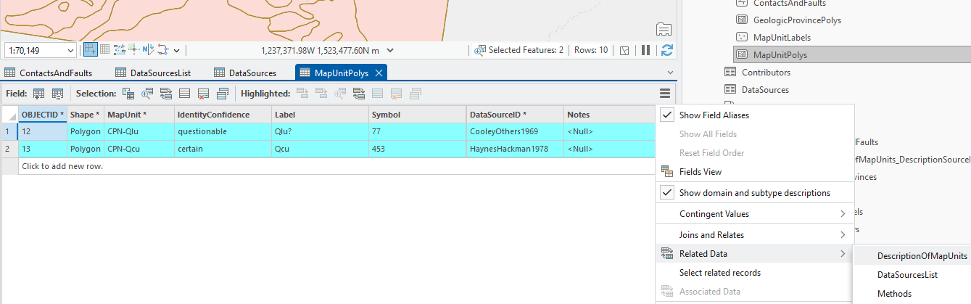
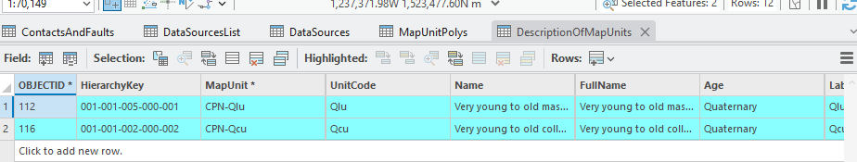
Map Unit Information—Feature class to table
MapUnitPolys

Slide 3
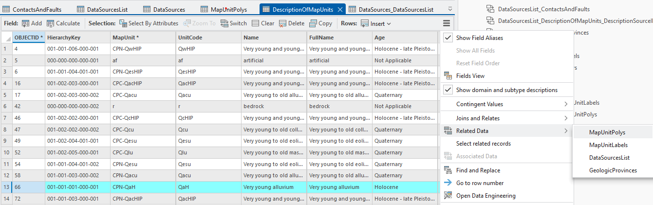
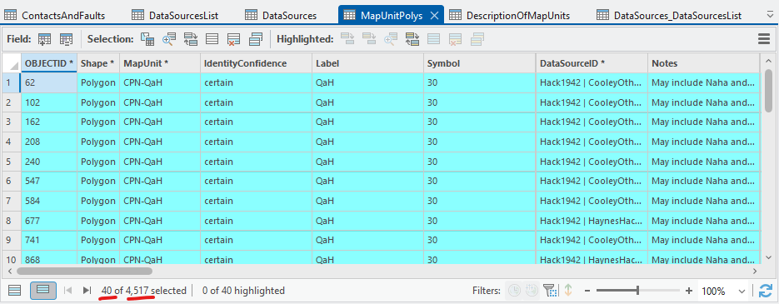
Map Unit Information—Table to feature class

Slide 4
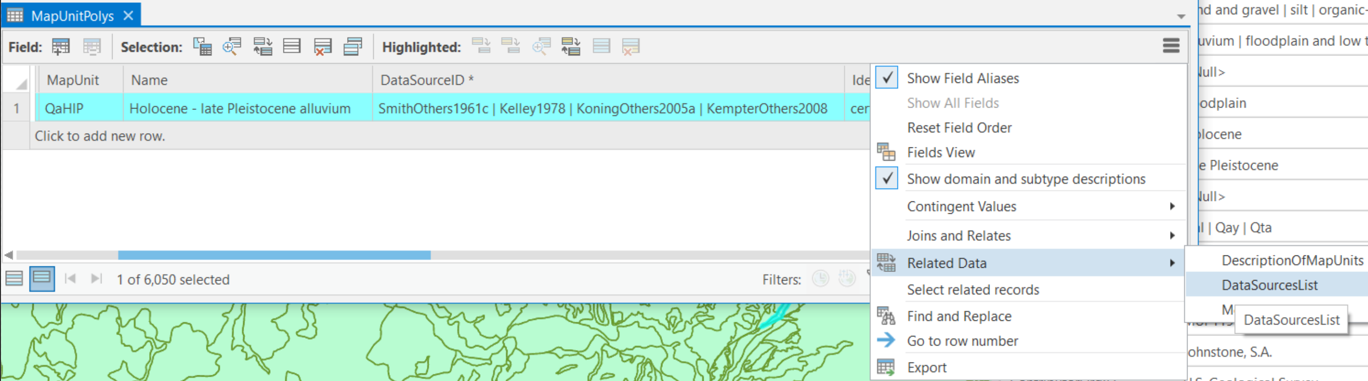
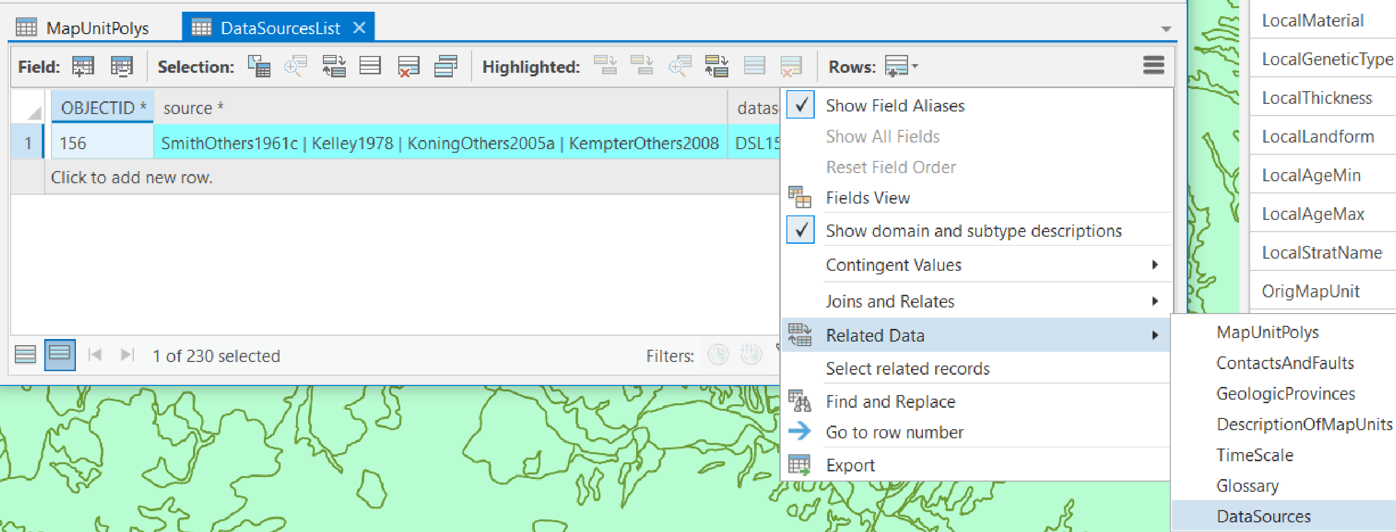
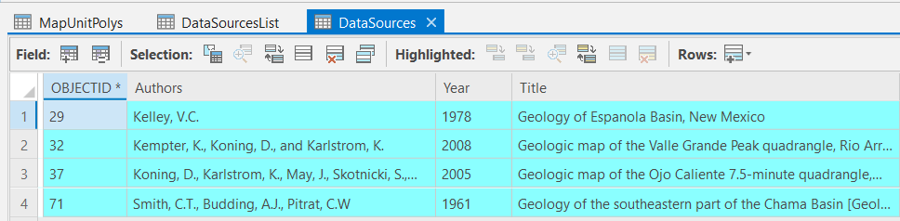
Data sources—Tables or feature classes to DataSources
MapUnitPolys
DataSourcesList
DataSources

