Slide 1
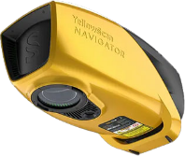
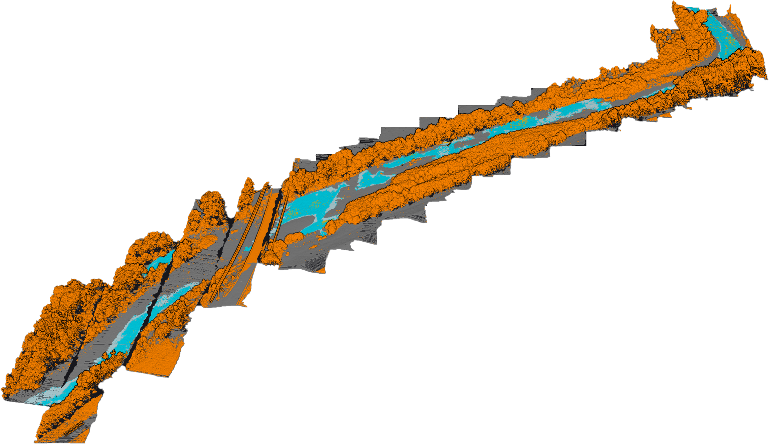


YellowScan Navigator UAS Bathymetric Lidar – Schoharie Creek, NY
Flight Paths – All North and South 60 m AGL
  Flight 1 – No overlap between transects 5 m/s
  Flight 2 – Overlap flight flown at 7 m/s
Lidar Resulting Point Density: 200.8 m2
Lidar Point Spacing: 0.07 m
Number of points: 21 million
Swaths: 49 Processed (FOV 40 degrees)
Returns: Up to 10
1 Laser Channels
Beam Divergence: 4 mrad
Experimental test data for informational purposes only.

Slide 2
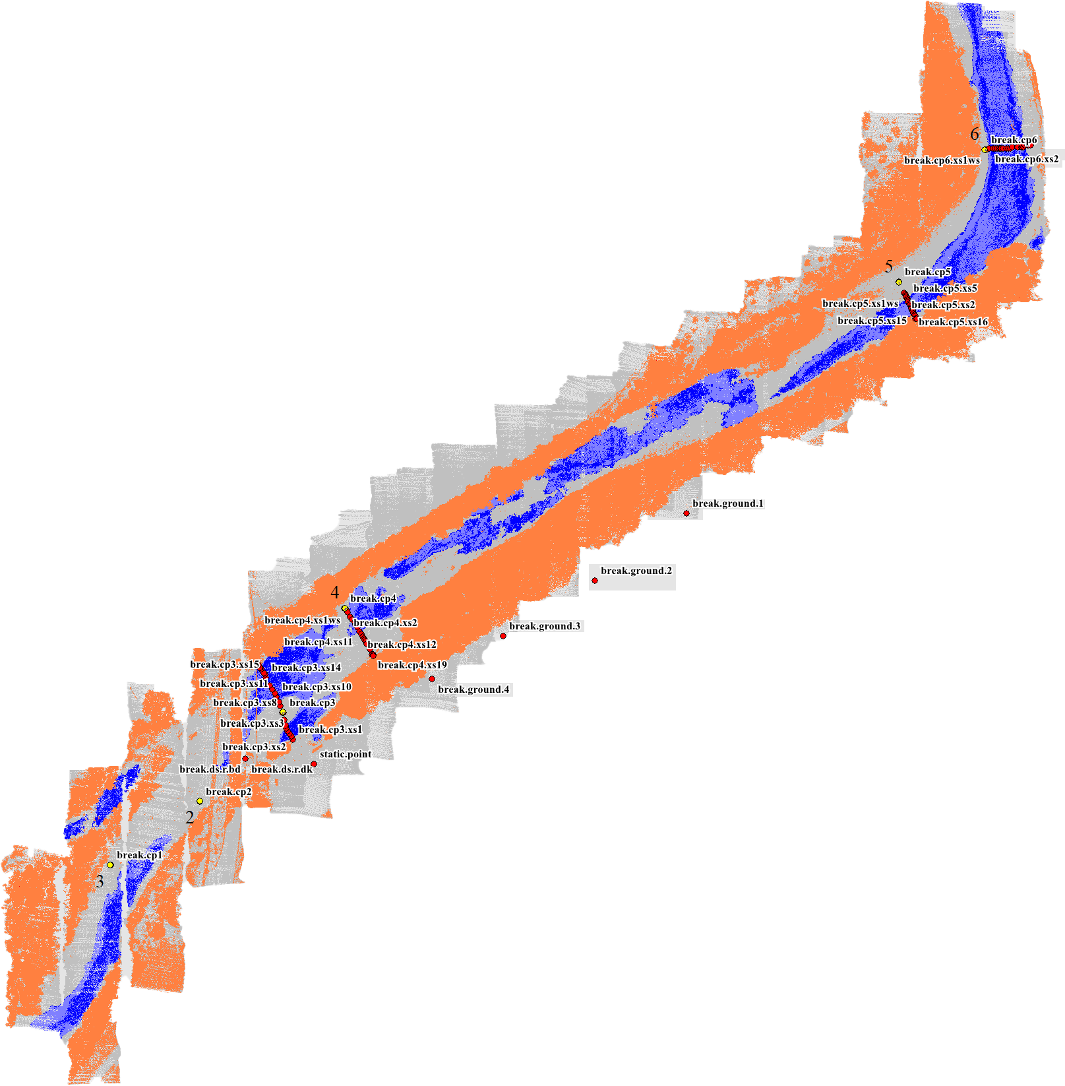
YellowScan Navigator UAS Bathymetric Lidar – Schoharie Creek, NY
Flight Paths – All North and South 60 m AGL
  Flight 1 – No overlap between transects 5 m/s
  Flight 2 – Overlap flight flown at 7 m/s
Lidar Resulting Point Density: 200.8 m2
Lidar Point Spacing: 0.07 m
Number of points: 21 million
Swaths: 49 Processed (FOV 40 degrees)
Returns: Up to 10
1 Laser Channels
Beam Divergence: 4 mrad
Experimental test data for informational purposes only.

Slide 3
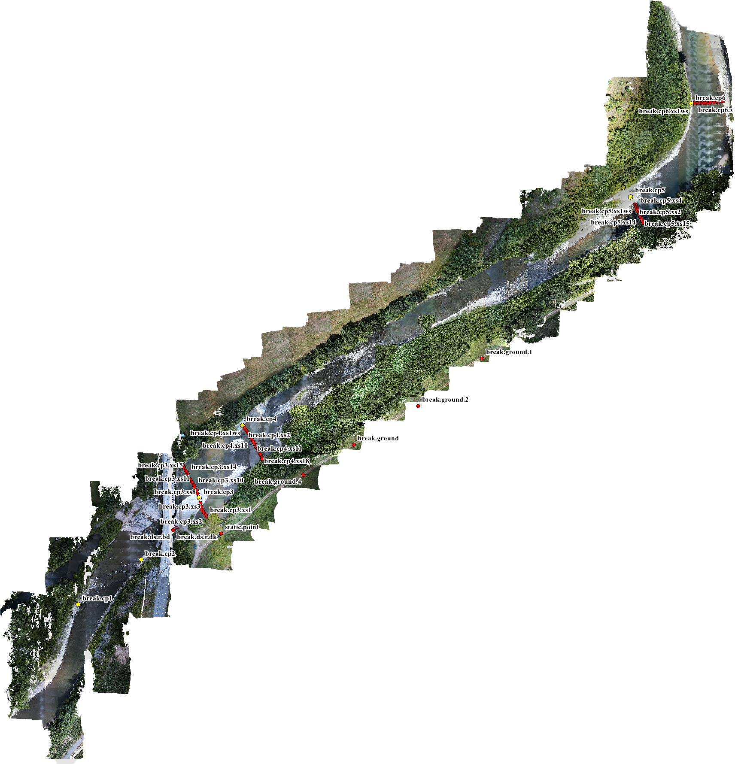
YellowScan Navigator UAS Bathymetric Lidar – Schoharie Creek, NY
Flight Paths – All North and South 60 m AGL
  Flight 1 – No overlap between transects 5 m/s
  Flight 2 – Overlap flight flown at 7 m/s
Frontier Precision Cross Targets
Aeropoints under the Frontier Precision targets
Experimental test data for informational purposes only.

Slide 4
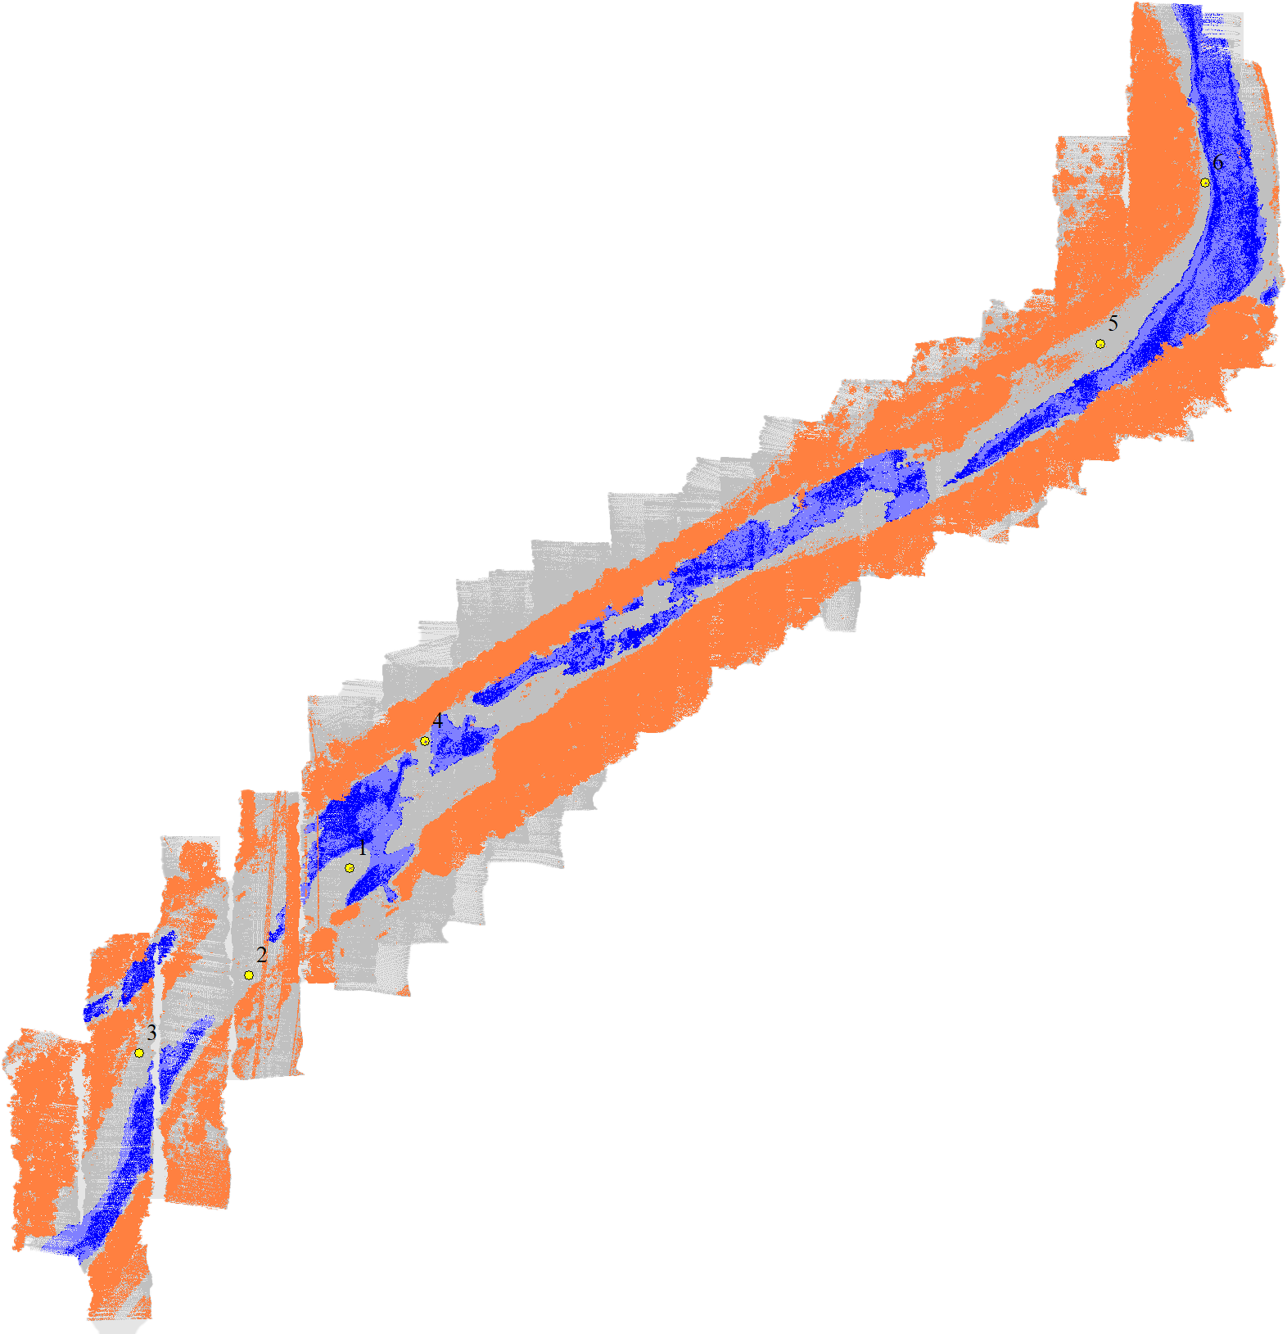
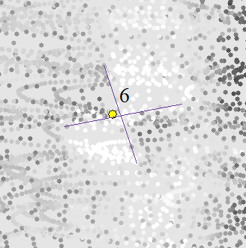
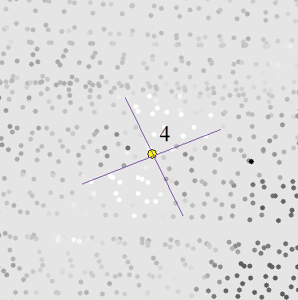
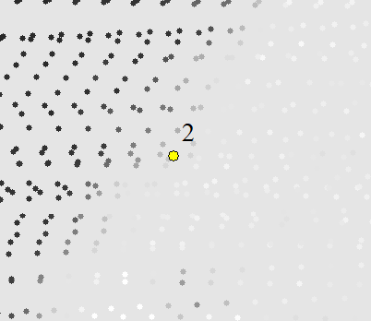
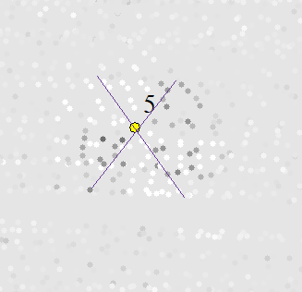
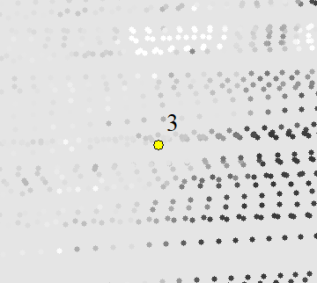
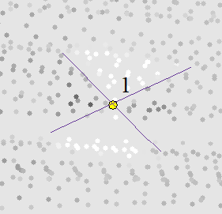
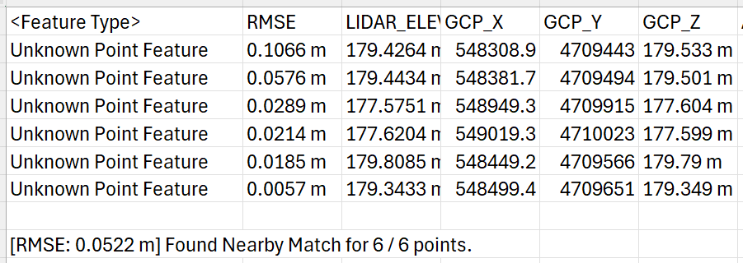
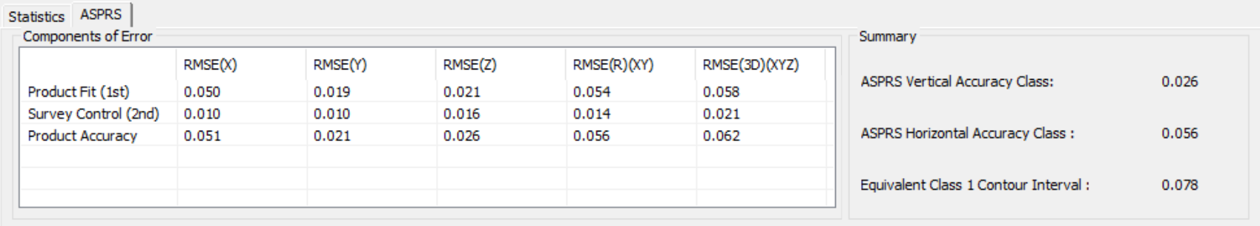
YellowScan Navigator UAS Bathymetric Lidar – Schoharie Creek, NY
Flight Paths – All North and South 60 m AGL
  Flight 1 – No overlap between transects 5 m/s
  Flight 2 – Overlap flight flown at 7 m/s
Frontier Precision Cross Targets
Aeropoints under the Frontier Precsion targets
Global Mapper Vertical Assessment
LP360 Horizontal & Vertical Assessment
Experimental test data for informational purposes only.

Slide 5
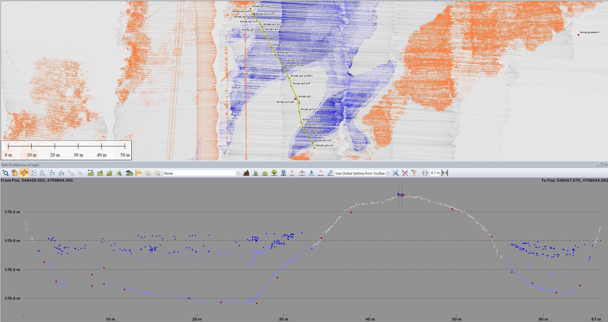
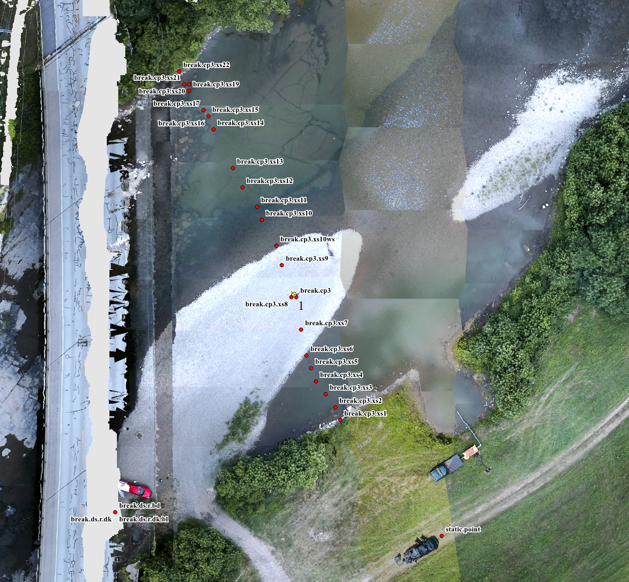
YellowScan Navigator UAS Bathymetric Lidar – Schoharie Creek, NY
Survey Line - CP3
20 cm Cross-Section Thickness
Experimental test data for informational purposes only.

Slide 6
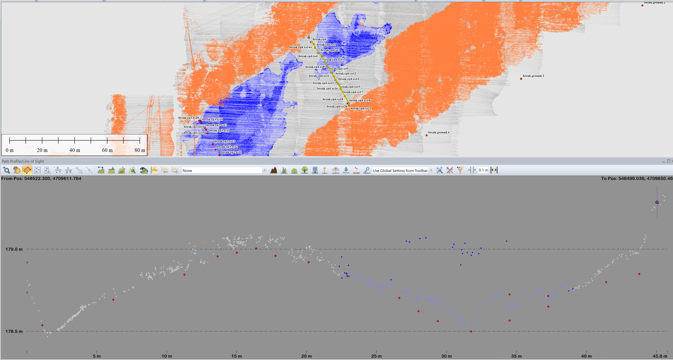
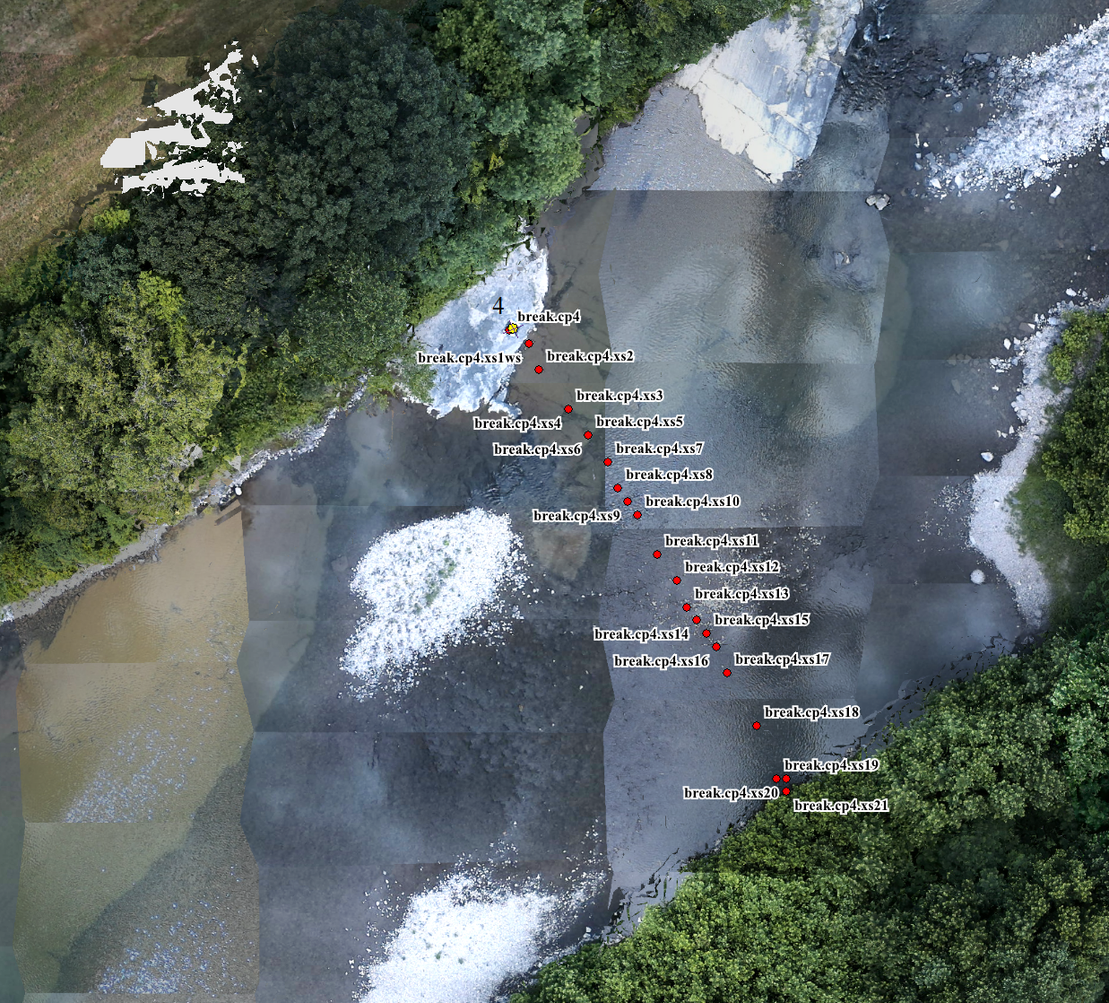
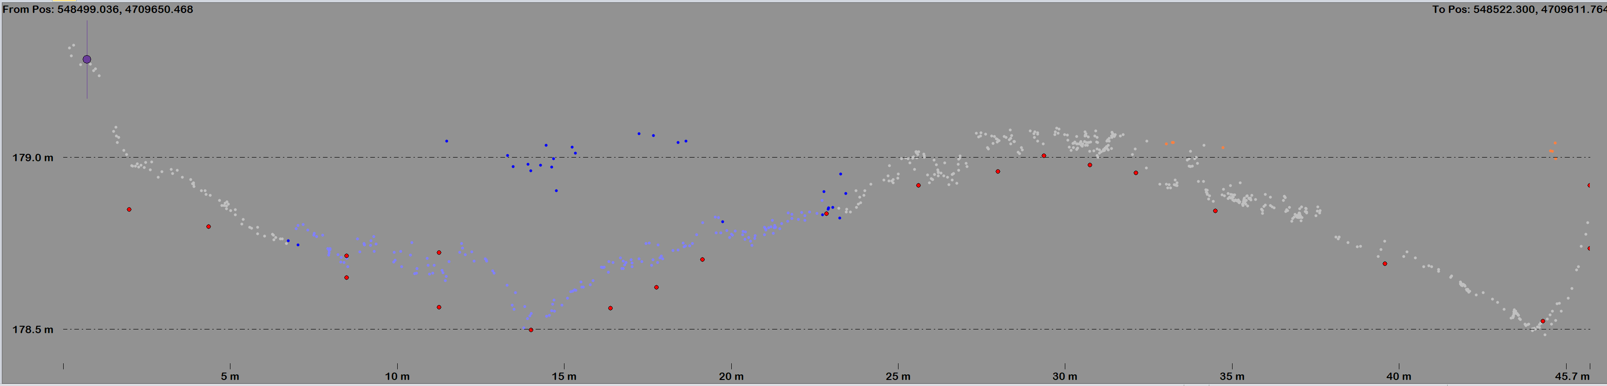
YellowScan Navigator UAS Bathymetric Lidar – Schoharie Creek, NY
Survey Line – CP4
20 cm Cross-Section Thickness
Experimental test data for informational purposes only.

Slide 7
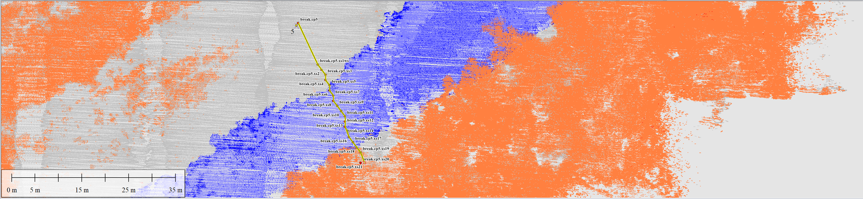
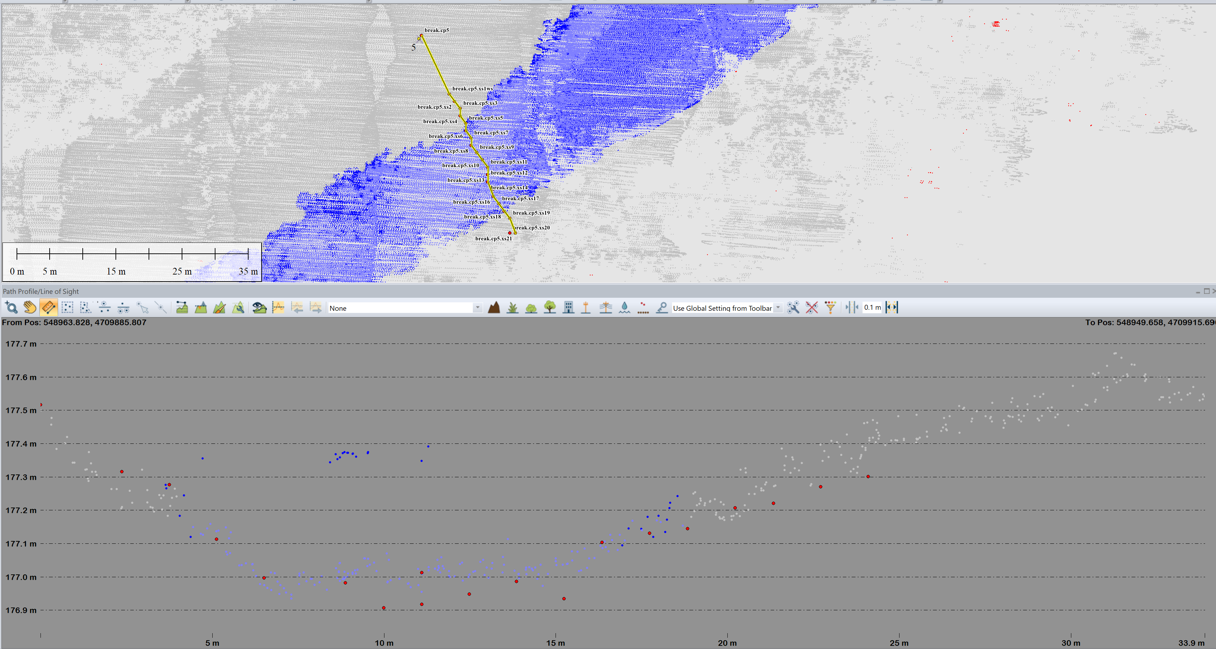
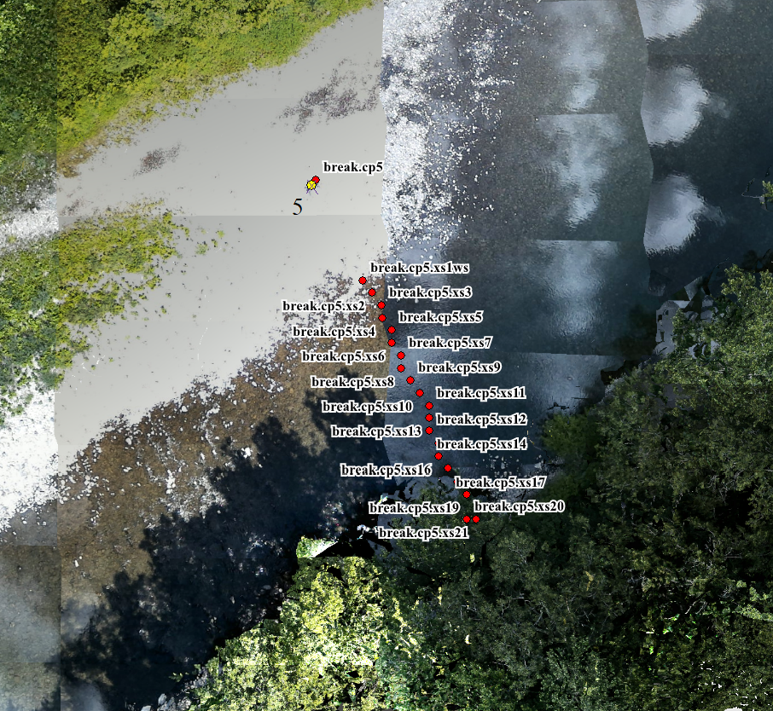
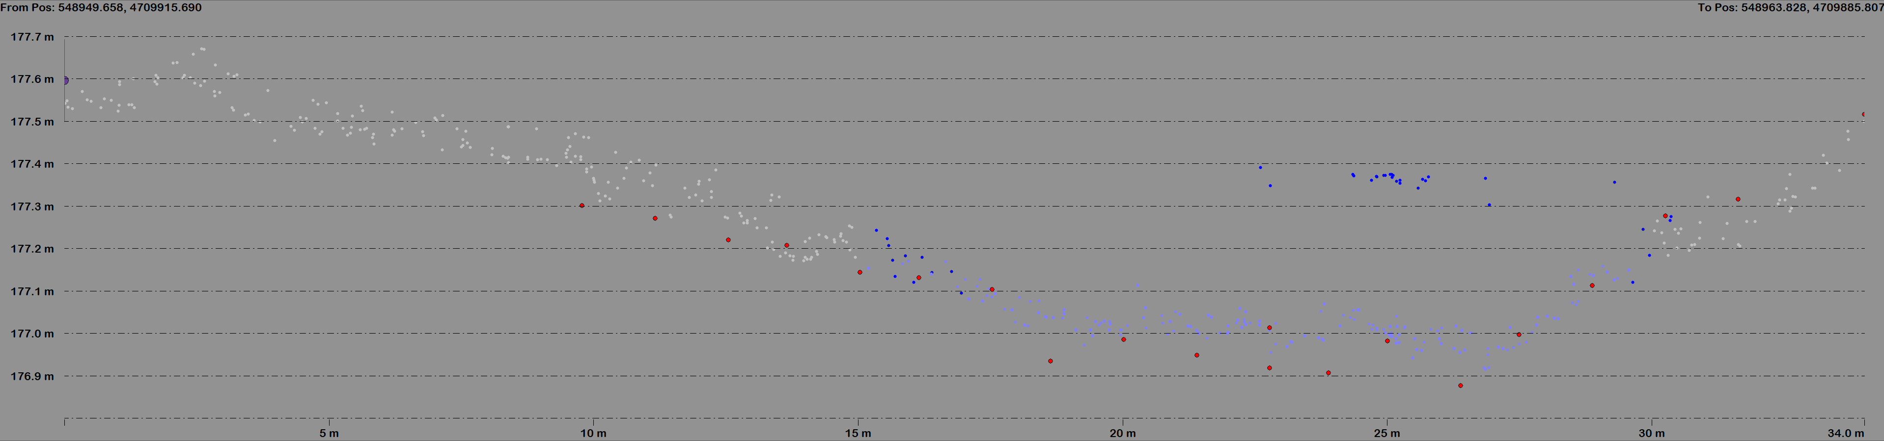
YellowScan Navigator UAS Bathymetric Lidar – Schoharie Creek, NY
Survey Line – CP5
20 cm Cross-Section Thickness
Experimental test data for informational purposes only.

Slide 8
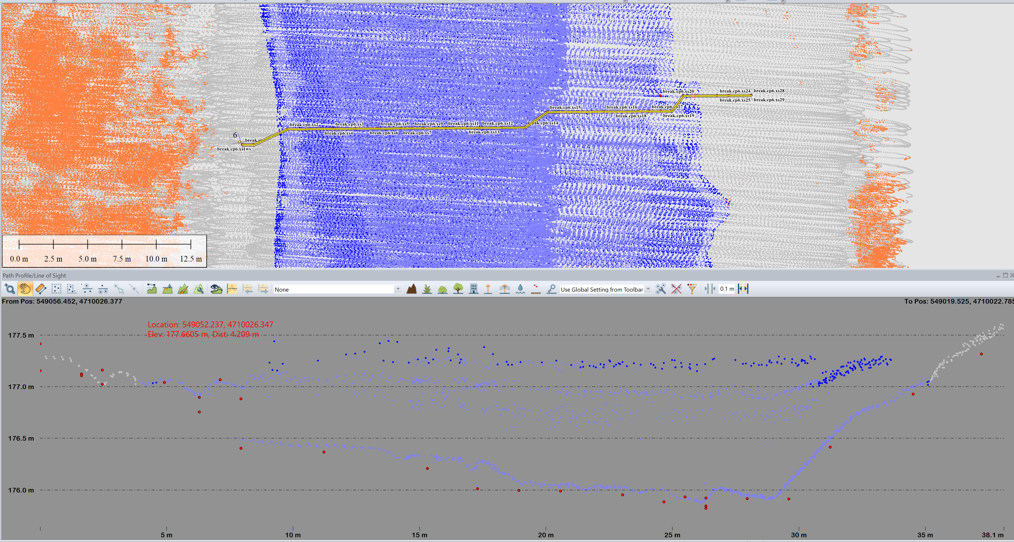
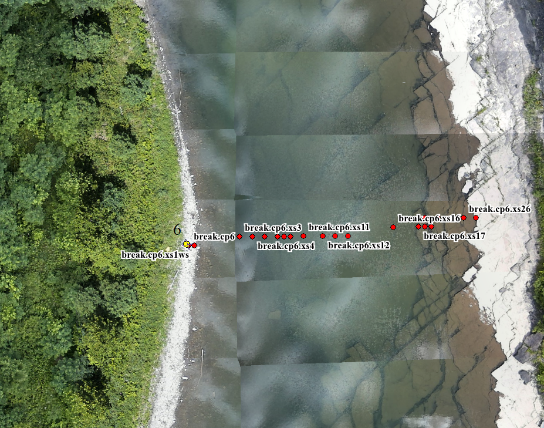
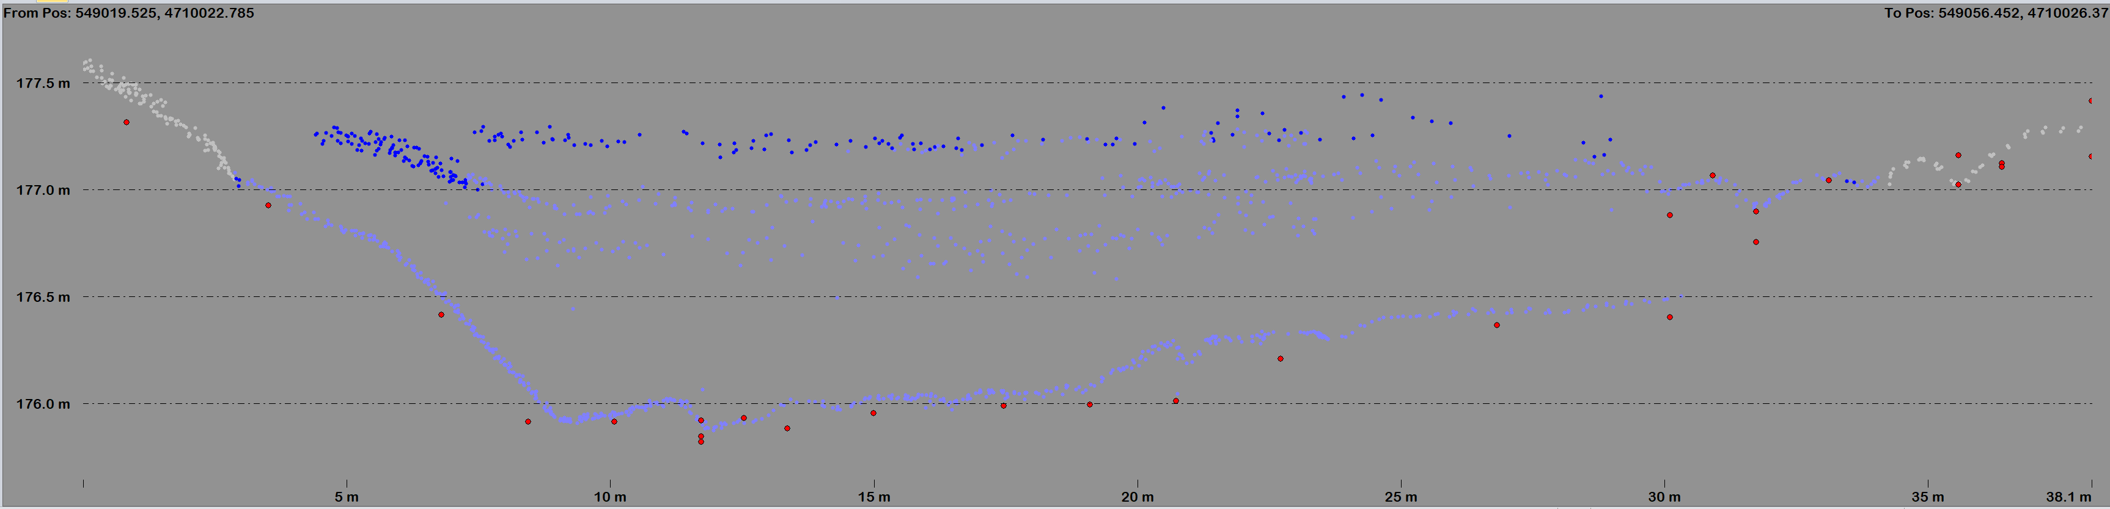
YellowScan Navigator UAS Bathymetric Lidar – Schoharie Creek, NY
Survey Line – CP6
20 cm Cross-Section Thickness
20 cm Cross-Section Thickness
1.2 meters
[RMSE: 0.0979 m] Found Nearby Match for 29 / 110 points.
Experimental test data for informational purposes only.

Slide 9
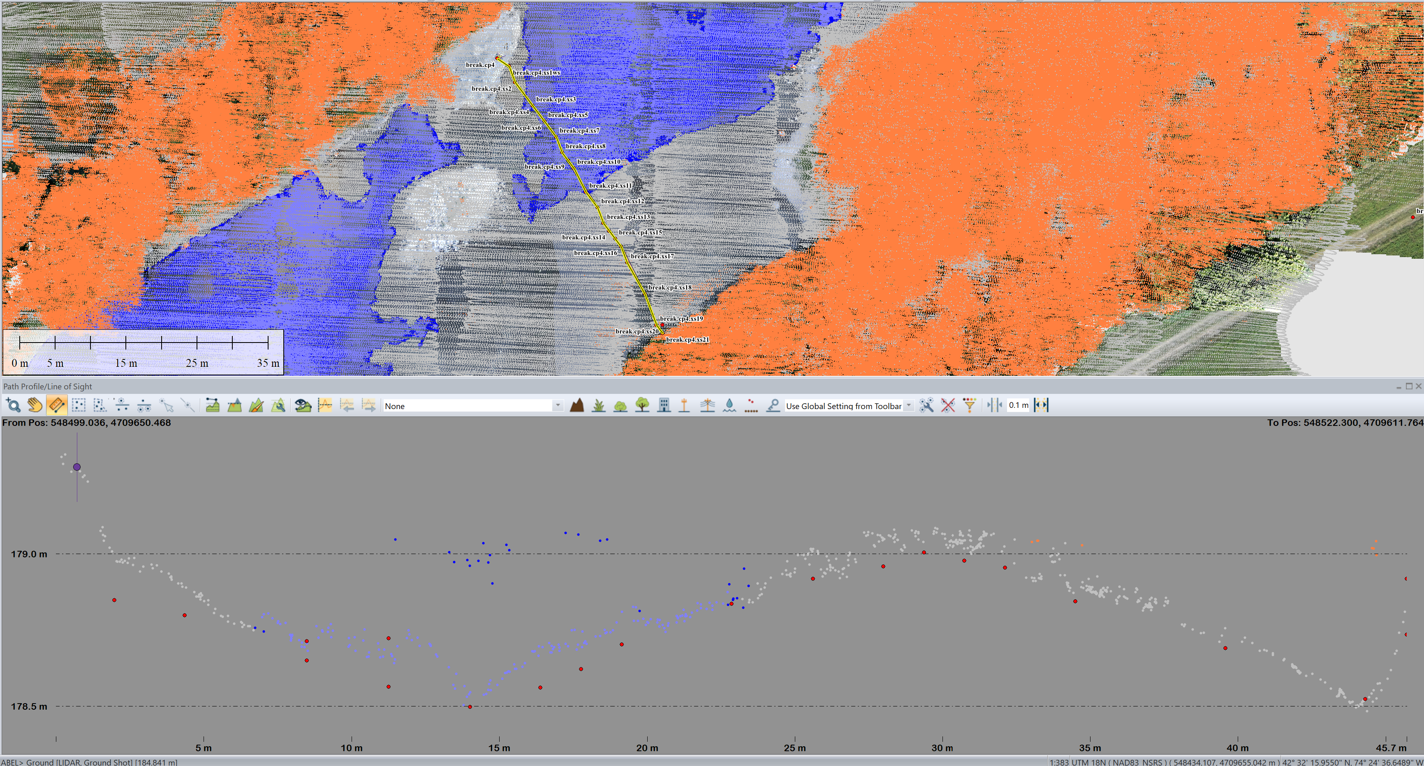
YellowScan Navigator UAS Bathymetric Lidar – Schoharie Creek, NY
Survey Line – CP4
20 cm Cross-Section Thickness
Experimental test data for informational purposes only.

Slide 10
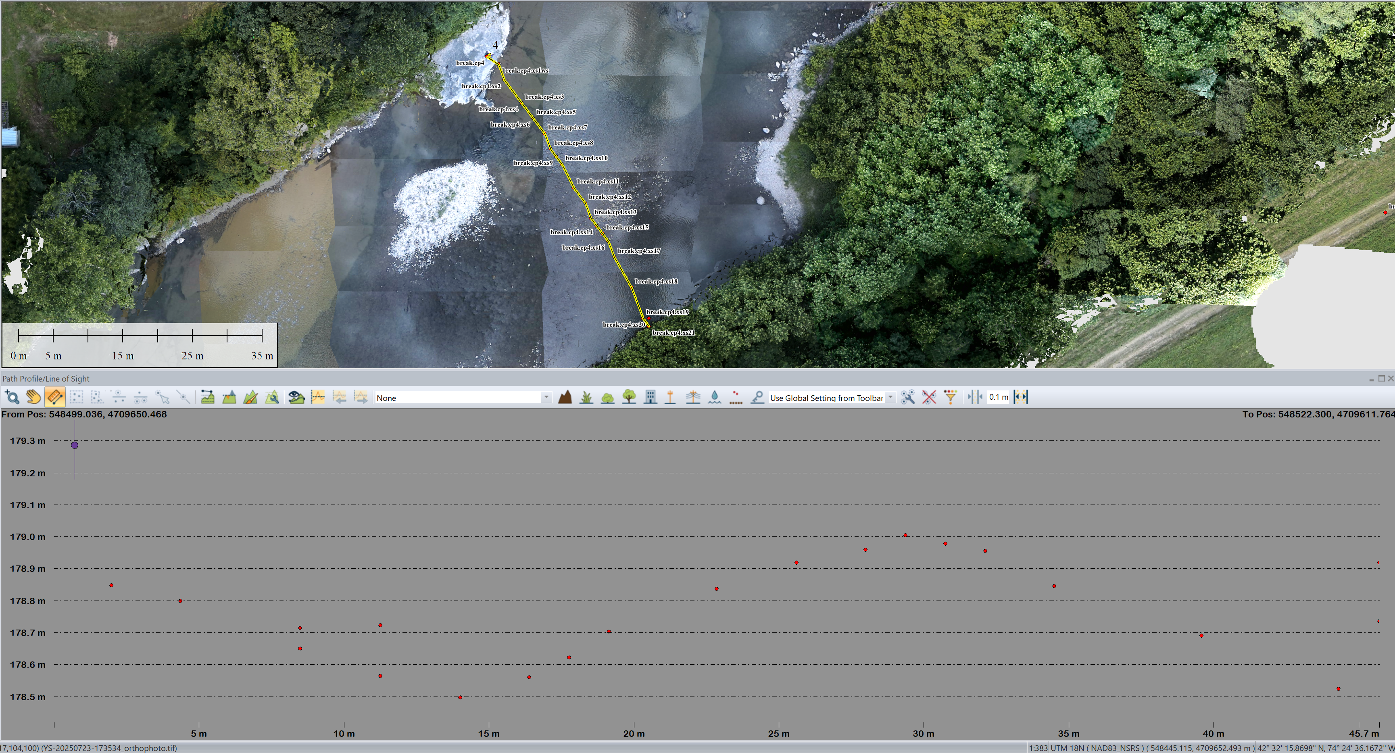
YellowScan Navigator UAS Bathymetric Lidar – Schoharie Creek, NY
Survey Line – CP4
20 cm Cross-Section Thickness
Experimental test data for informational purposes only.

